Slide 1
Evaluating the impact of artificial intelligence in customer service for tech companies
MCA Final Year Project
Developed By: Devinderjeet Singh
Technology Used: Python, Streamlit, SQLite, Machine Learning, NLP

Slide 2
Project Introduction
Artificial Intelligence is transforming customer service.
Companies use AI for chatbots, automated replies, sentiment analysis, and customer support analytics.
Objectives:
Analyze AI trends in customer service
Study benefits and challenges
Evaluate customer satisfaction
Generate insights and reports

Slide 3
Technologies & Tools
Python – Core programming
Streamlit – Dashboard UI
SQLite – Database
Pandas – Data analysis
Matplotlib – Visualization
Scikit-learn – Machine Learning
TextBlob – NLP Sentiment Analysis

Slide 4
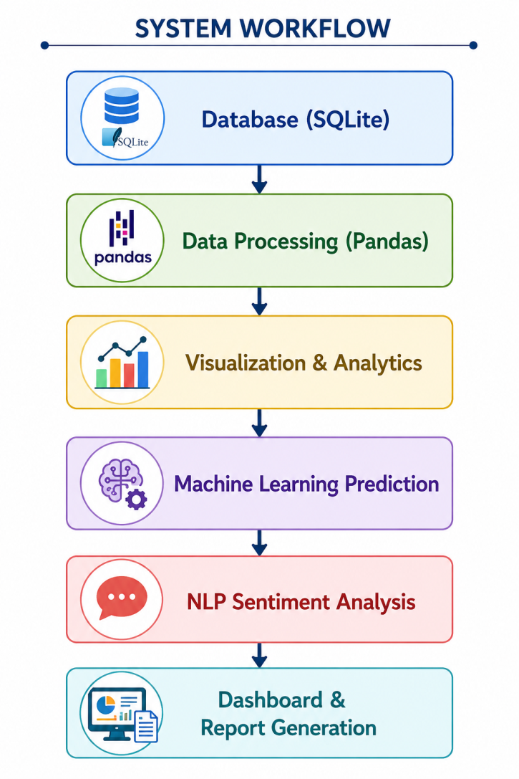
System Architecture

Slide 5
Dashboard Features
Interactive Dashboard
AI Usage Analysis
Customer Satisfaction Analysis
Response Time Analysis
Machine Learning Prediction
NLP Sentiment Analysis
Downloadable Reports
Database Integration

Slide 6
Machine Learning & NLP
Uses Linear Regression
Predicts customer satisfaction
Based on response time
Uses TextBlob for Sentiment Analysis
Detects Positive, Negative, and Neutral feedback

Slide 7
Results & Benefits
Faster customer analysis
Improved decision-making
Better customer understanding
Increased efficiency
Working AI dashboard
Real-time analysis
Visualization of customer insights

Slide 8
Conclusion & Future Scope
Successfully integrates Database, ML, NLP, Visualization, and Dashboard.
AI improves customer service through automation and sentiment analysis.
Future Scope:
Chatbot integration
Cloud deployment
Advanced AI models
Real-time analytics

Slide 9
Thank You
Questions & Discussion
AI Customer Service Dashboard
Developed Using Python + Streamlit + AI + NLP

